Slide 1

Aditya surampalem
Aditya global business school

Slide 2
Motorola PAGER
THE TITANS
Nikhil 10. Navya
Soma Raju
Lokesh
Vijay
Veerababu
AAsritha
Deena
Geetha
KiranmaYi

Slide 3
Industry profile
Motorola inc. was established on September 25,1928.
It was founded in 1928 Chicago by brothers paul and joseph Galvin as the
manufacturing corporation.
in 1960 John Francis Mitchell combined elements of Motorola’s walki-talkie and automobile radio technologies to create the first transistorized pager, and from that time, paging technology continued to advance and pager adoption among emergency personnel is still popular as of July 2016.
Pagers, also known as beepers, are small electronic communication devices that were widely used in the past for sending short text messages or numeric codes to individuals. They typically displayed the message or code on a small screen and emitted a beeping sound to alert the recipient.

Slide 4
Advantages & limitations of pager technology
advantages
disadvantages
Limited Functionality
Lack of Two-way Communication
Outdated Technology
Cost
Limited Information
Reliability
Battery Life
Immediate Notification
Privacy

Slide 5
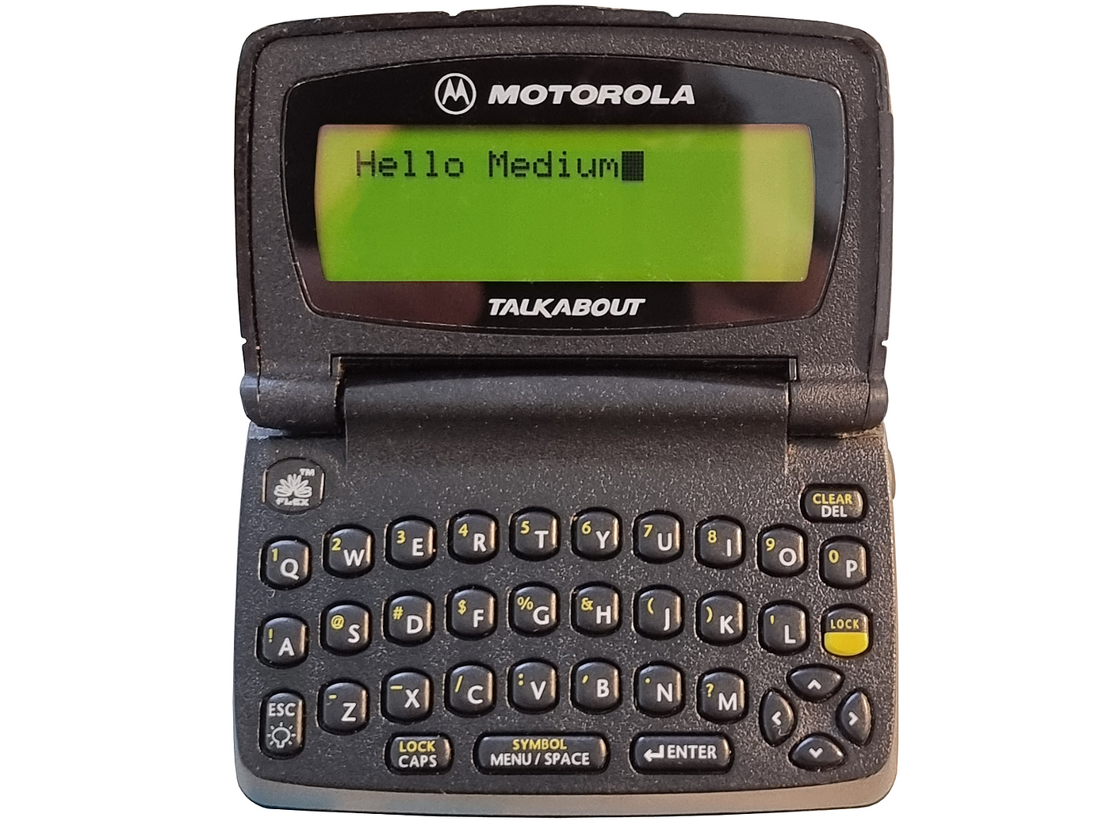
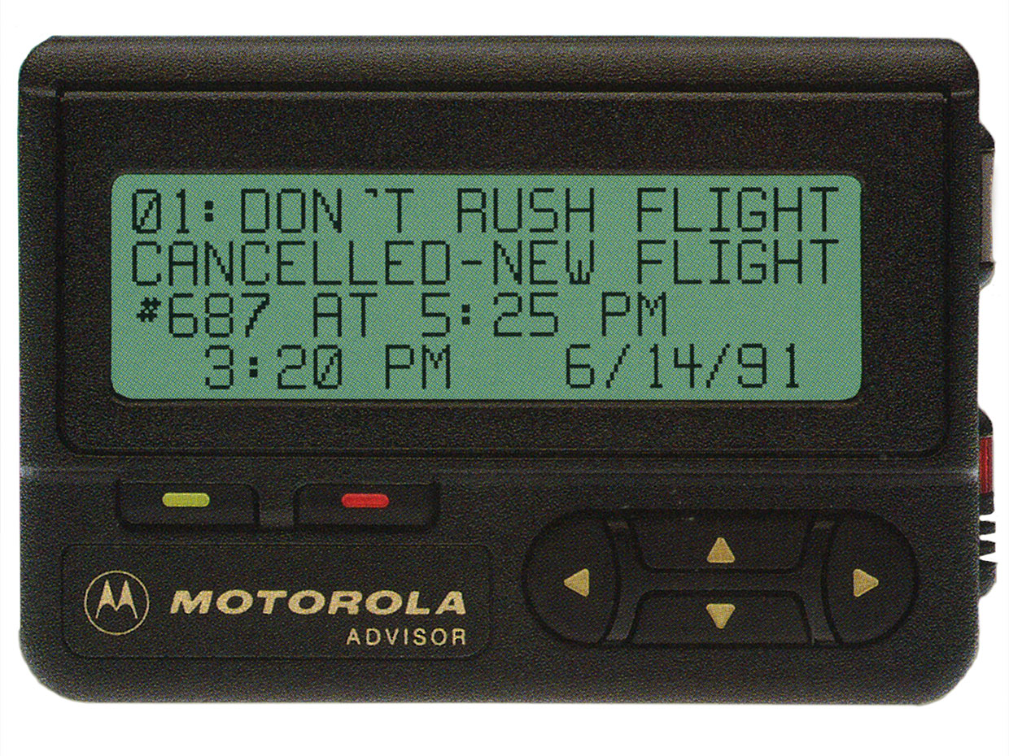
usage of pager
Emergency medical personnel communication. On-call professionals (doctors, technicians, etc.).Coordination in industrial settings. Messaging in noisy or restricted areas. Alerting services (firefighters, paramedics).Security and surveillance teams. Communication in areas with limited cell coverage. Critical event notification.
They gained popularity throughout the following decades and became a common means of communication in the 1980s and 1990s, particularly among professionals who needed to be on call or reachable in emergencies.
Motorola played a significant role in the development and popularization of pagers. In fact, the first practical pager, known as the "Motorola Pageboy," was introduced by Motorola in the 1950s. This marked the beginning of widespread use of pagers for communication.

Slide 6
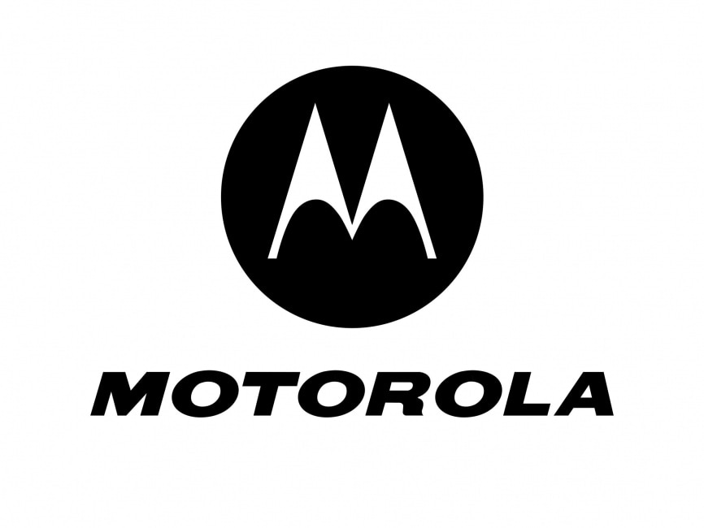
Problem of industry
Advancements in mobile phone technology. Limited functionality for one-way communication. Inability to send detailed messages. Lack of privacy and security. Dependence on coverage areas. Inconvenience of carrying multiple devices. Preference for text and multimedia messaging. Competition from smartphones and mobile apps.
Motorola gradually phased out its pager business over a period of time, starting in the early 2000s. The exact timeline may vary for different regions and product lines, but Motorola's exit from the pager market was driven by the declining demand for pagers and the company's shift towards other telecommunications and technology products.

Slide 7
Idea and solution for the problem
Enhanced Features
Integration
Specialized Use Cases
IoT Integration
Long Battery Life
Security
Customization
Retro Appeal
Environmental Considerations
Affordability

Slide 8
Market research
By the 1970s, tone and voice pagers were invented. After the tone, the pager relayed an audio message. This was a big improvement because the recipient was immediately given more information such as “Code Blue in CIU.”
But it wasn’t until the 1980s that pager use exploded. To have one hanging from a belt loop, shirt pocket, or purse strap was to convey a certain kind of status — that of a person important enough to be reached at a moment's notice. Like today's emoji-savvy texters, pager users eventually developed their own form of shorthand communication.
There were 3.2 million pager users worldwide in the early 1980s. Pagers had a limited range and were used mostly in on-site situations —when medical staff needed to communicate with each other in the hospital. At this time, Motorola was also producing devices with alphanumeric displays, which allowed users to receive and send a message through a digital network.
A decade later, broad-area paging became available and more than 22 million of the devices were in use. By 1994, more than 61 million were in use, as pagers became popular for personal communications as well. Pager users could send any number of messages, from "I Love You" to "Goodnight," all using a set of numbers and asterisks. While Motorola stopped producing pagers in 2001, they are still being manufactured. Spok is one company that provides a variety of paging services, including one-way, two-way, and encrypted.
Paging networks are often viewed as more reliable than cellular or wi-fi networks. Even the best of those networks still have dead zones and poor in-building coverage. Pagers instantly deliver messages with no lags in delivery. So, until cellular networks become just as reliable, the "beeper" remains the best form of communication for those working in the critical communications fields.

Slide 9
strategies and target customers
strategies
Target customers
Online Presence
Content Marketing
Email marketing
Influencer Marketing
Online Advertising
Trade Shows and Industry Events
Collaborations• Customer Reviews
Limited-Time Offers and Discounts
Data Privacy and Security
Sustainability
Community Building
Healthcare Professionals
Emergency Services
Industrial Workers
Security Personnel
Event Organizers
Outdoor Enthusiasts
Students

Slide 10
financial BUDGETING
Based on the features same as the mobile phone but can provide various other advantages like smart touch scree, also the components that are used in the pager we want to develop consists of color display, and an antenna which provides uninterrupted signals in distant areas, and also provide shortcuts in sending via voice messages, and able to connect to all the other devices which provides two way communication and its looks may matter, and browsing features. the budget for releasing it in public would be 7000 because it should be cheap and reliable and in upcoming year we might wants to add a new software for all people which help them use voice commands which is most helpful for older people and people with disabilities
Where as it can become an mini laptops in hands of students and can also used for professional uses like office preposes etc.

Slide 11
Conclusion
In this conclusion I tell you that in this 21th centaury the pager can get into demand with right features for right persons. But the companies does not want to go with the old technology.
but I can say that with the right mind with right plan a pager can be upgraded to the latest technology and it can become the competitor for other communicative devices and become one of the emergency gadget for many professional. Like in hospitals, army forces and in times trekking etc.

Slide 12


